Slide 1

Rockbuster Stealth LLC Data Dictionary
Drew Ballinger

Slide 2
Table of Contents

Slide 3
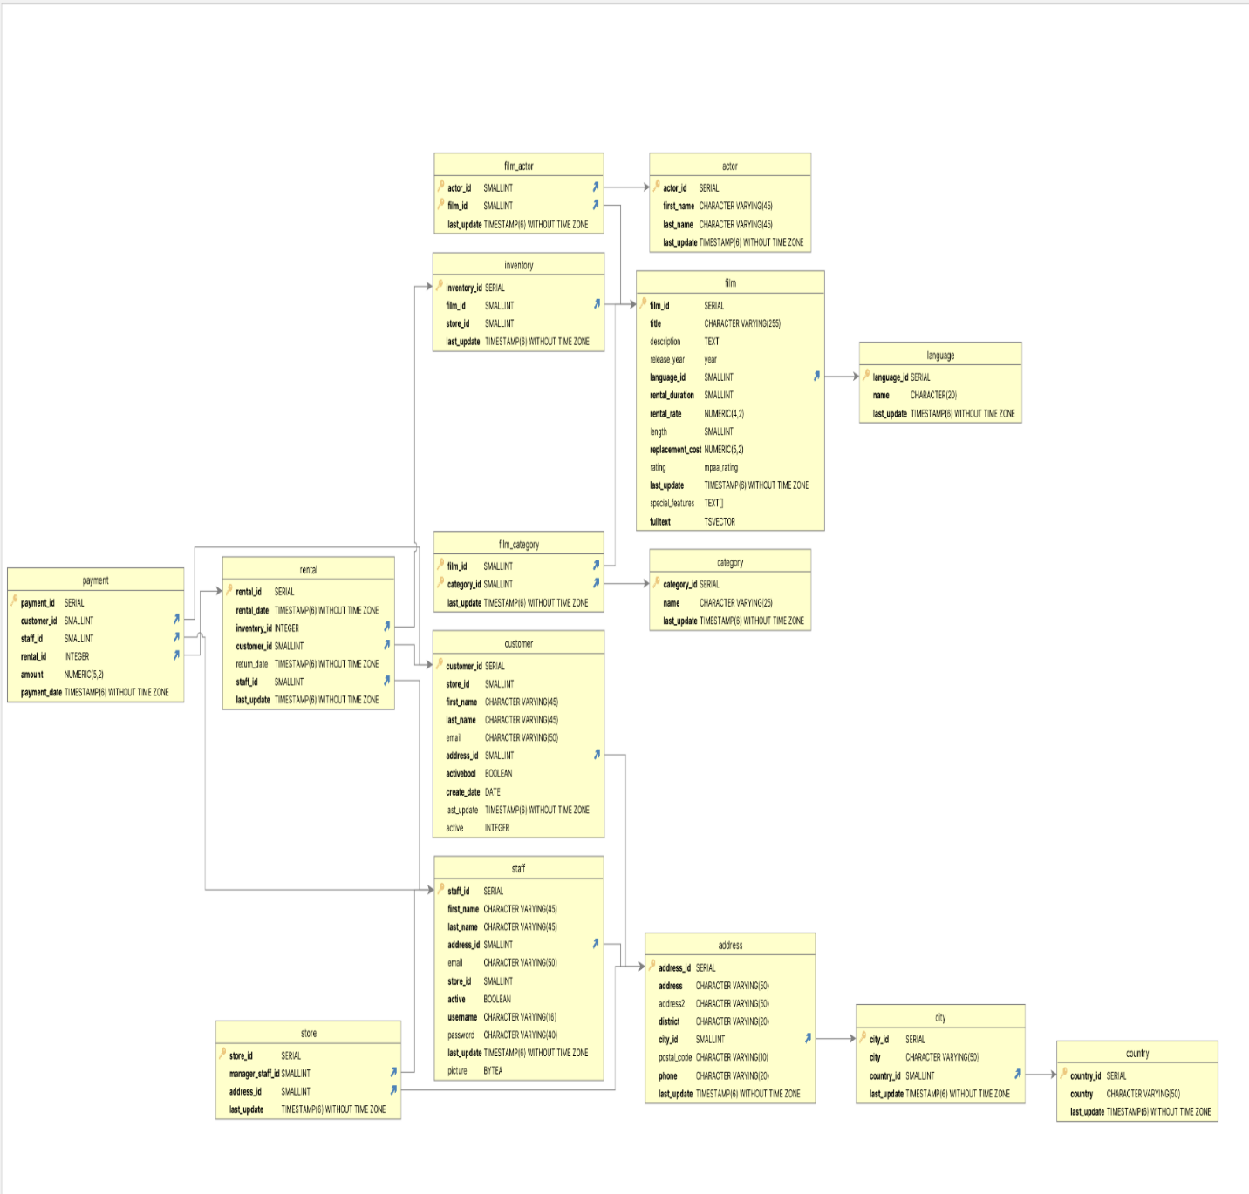
Rockbuster Database Schema / ERD

Slide 4
Fact Table

Slide 5
Fact Table

Slide 6
Dimension Table

Slide 7
Dimension Table

Slide 8
Dimension Table

Slide 9
Dimension Table

Slide 10
Dimension Table

Slide 11
Dimension Table

Slide 12
Dimension Table

Slide 13
Dimension Table

Slide 14
Dimension Table

Slide 15
Appendix

